Slide 1



Storing Data as Code
www.linkedin.com/in/nowiski
Code + Data = Tasty
Jeff Nowiski
2021-02-16
https://www.meetup.com/tripass/

Slide 2




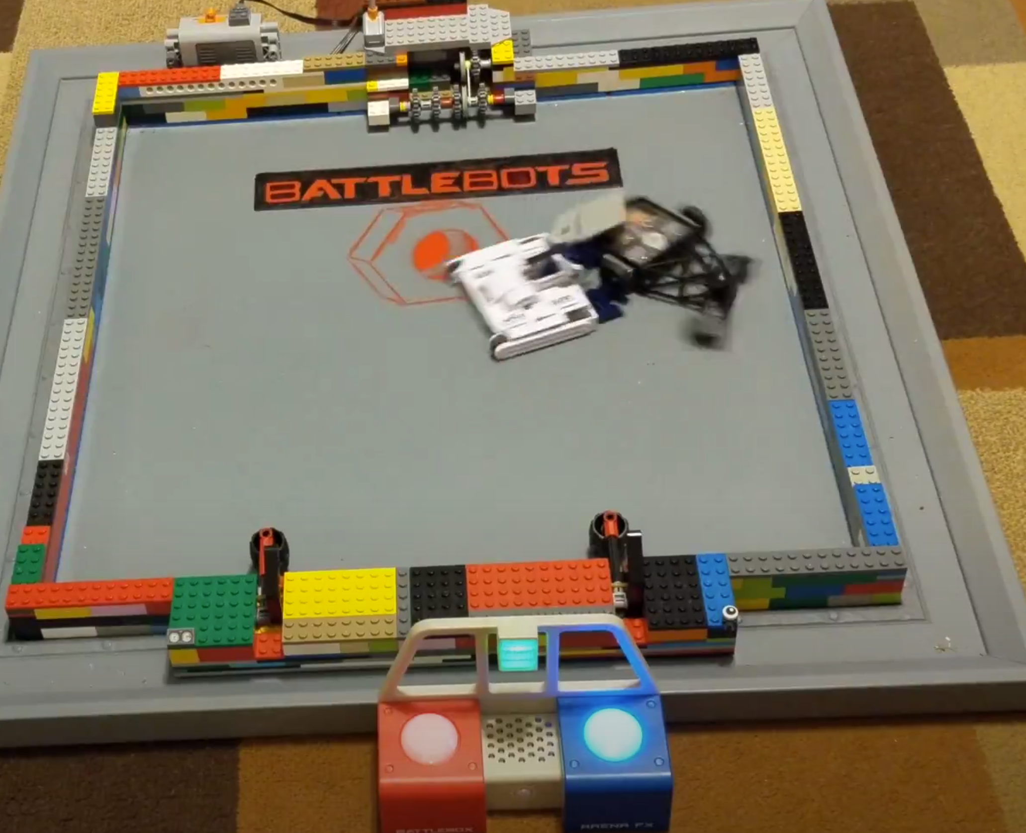
Contact Info
Jeff Nowiski
https://www.linkedin.com/in/nowiski/
https://sqlcommunity.slack.com/
@jeffalope

Slide 3
Who am I?
Jeff Nowiski
Database Engineer at Citrix
Interests
PowerShell so I can be lazier
tSQL tuning so that I can make things go fast
Carolina Hurricanes hockey because baseball is boring
Battlebots because my younger son is obsessed
Minecraft because my older son is obsessed
Ultimate Frisbee because the sweet hucks
Puns because they are the highest form of humor
As a millennial avocado toast is important to me

Slide 4


Overview
Why do we need to store data with the code
Static Data in Procedures (or views)
SQL Agent Job Definition in Procedures
SSIS Packages in Procedures

Slide 5

Why should store data in code
There are plenty of ways that I have seen static data maintained
Replication
Complicated spreadsheet with VBA
Files that need to be imported from external system
Hand rolled insert/update/delete scripts
Application (and database) Installer
Hopefully, we are all storing our database schema in source control
Static data is just an extension of our code base
So just treat it that way
Works well with state based or migration based deployment models
Allows for the same code review processes you have in place

Slide 6

Demo Time
Static data
SQL Agent Job
SSIS Package

Slide 7

Summary
Logic can be embedded in the procedures to be very flexible
Flexible to support complexity by
Server
Environment
Region
Database admins/engineers understand procedures
Configuration is in the same place as the rest of the database code
Static data changes are treated just like any other released code
Existing review processes can be utilized
Easy to schedule process to periodically correct any drift

Slide 8

Comments/Questions

Slide 9

Resources
Slides/examples
https://github.com/jeffalope/public_presentations
Images from
https://www.pexels.com/

